Slide 1
Website Optimization and Content Strategy
DigiKnow Webinar, 7.18.12

Slide 2


Slide 3
Web Site Optimization 101
Michael “Spell” Spellacy
DigiKnow, July 18, 2012
Notes:
Hello and welcome to UI Superfriends: Web Site Optimization 101. While this presentation is aimed at development and creative teams, it is important for all who are involved in the creation of web sites to understand why optimization is just as integral to the success of a project as great content, beautiful design and kick-ass functionality are.

Slide 4
Why Optimize?
Improved User Experience
Mobile! Mobile! Mobile!
Notes:
Sadly, web site optimization is usually not given much thought and put on the back burner. We need to be mindful of optimization so that we can create an awesome user experience. The faster a website is the happier our end users (and clients) will be. Mobile has also become a wake up call for site optimization as overburdened pages can wreak havoc on our users data plans.

Slide 5
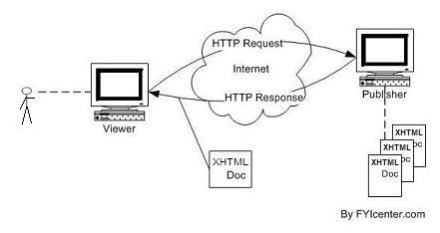
HTTP Request Explained
Notes:
One of the biggest problems a site can run into is having too many HTTP Requests. When you request a web page from a server, it is returned to your browser. Additional requests are also made to all of the assets a page will need to render as designed. CSS, Scripts, Iframes, Images etc. The more assets a given page has, the longer it will take that page to load. Simple.

Slide 6
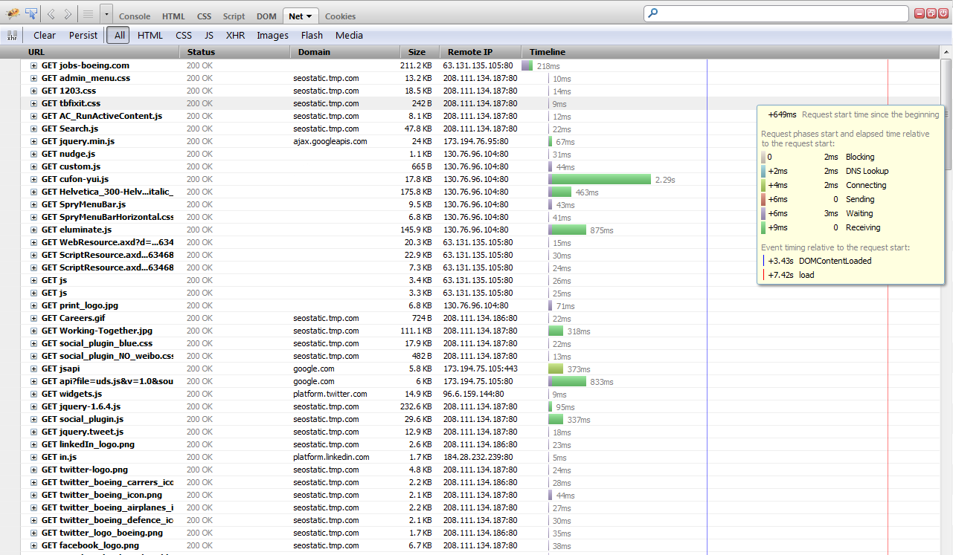
This is an HTTP request…
Notes:
Here we have an example of one our own sites making several HTTP requests to complete it’s job.

Slide 7
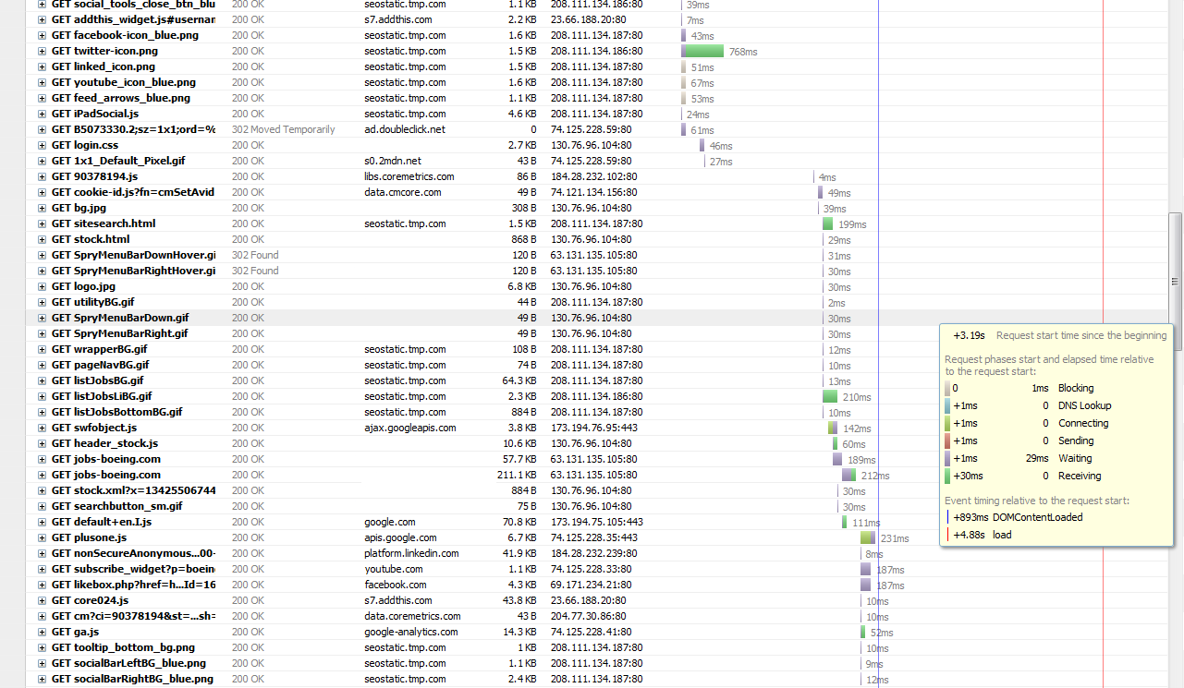
…that goes on…
Notes:
Unfortunately, this request goes on….

Slide 8
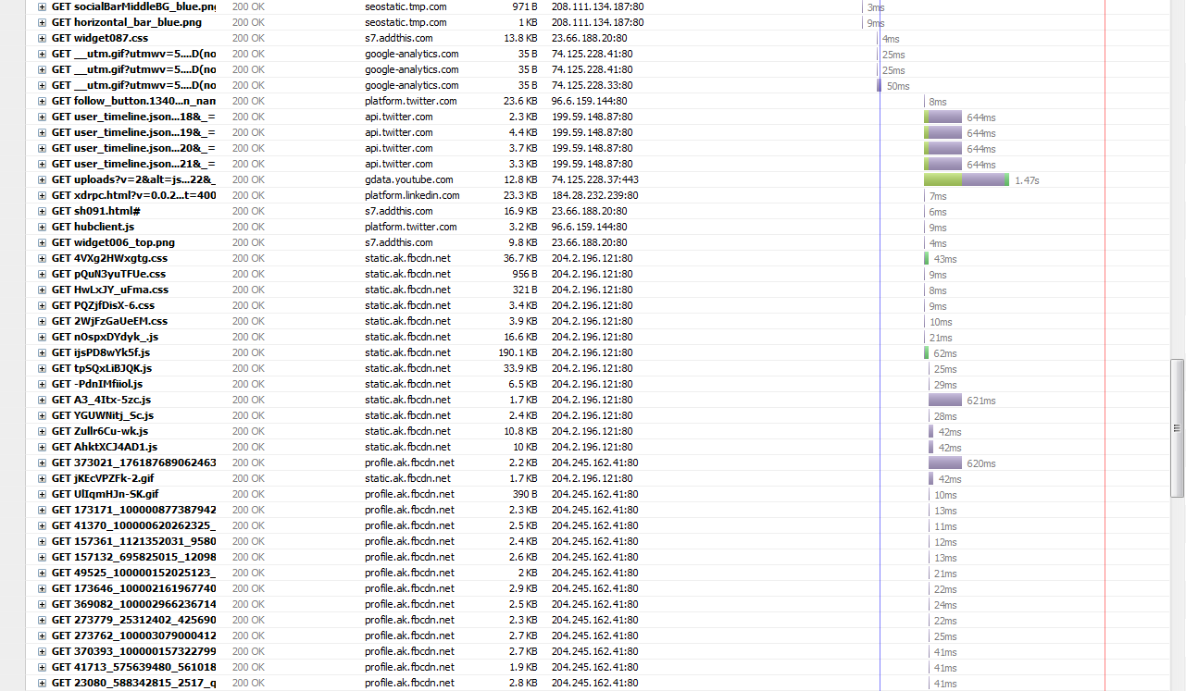
…and on…
Notes:
…and on…

Slide 9
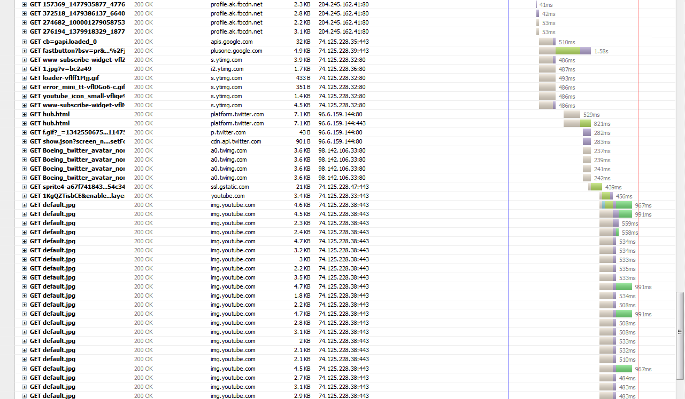
…and…on…
Notes:
…and…on….

Slide 10
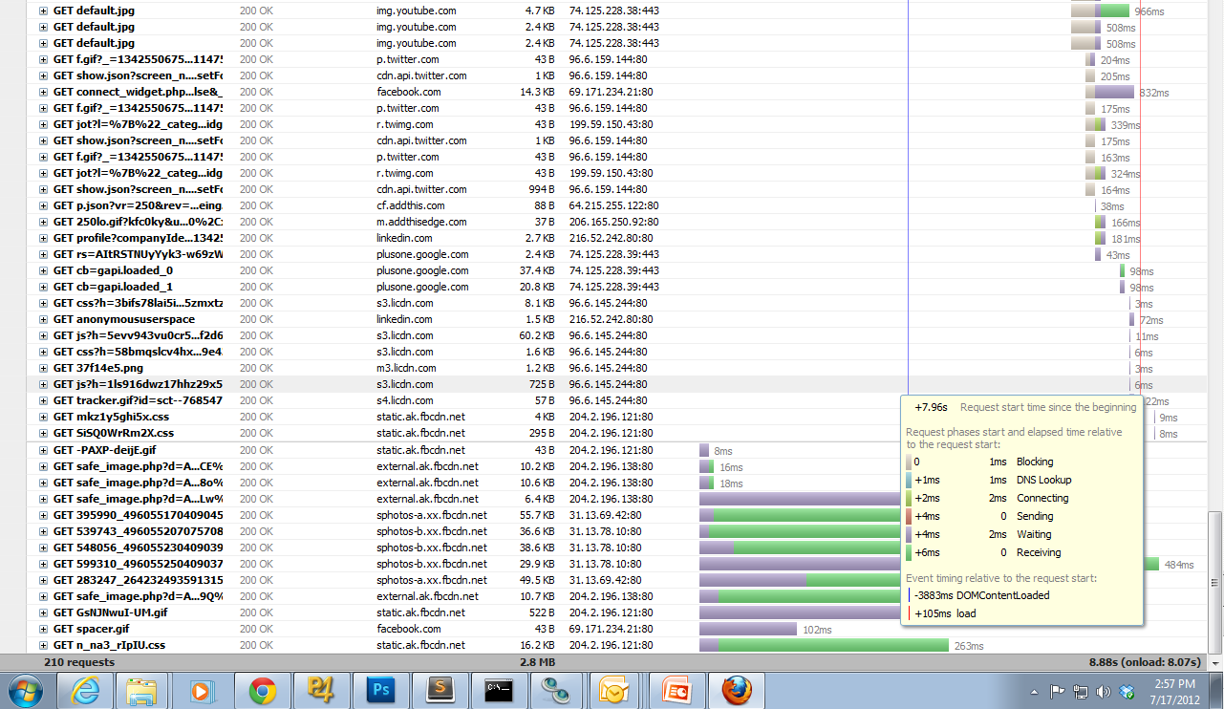
…and on.
Notes:
…and…on.

Slide 11

FAFAFAFAFA!!!
Notes:
I’ll let this sink in.

Slide 12
Yikes!
Total HTTP Requests Made: 210
Total Page Weight: 2.8 MB
Multiple HTTP Requests + Large Page Weight = A Bad User Experience
Notes:
A total of 210 HTTP requests are made to various servers here. The cumulative weight for the page and all of it’s assets weigh in at a hefty 2.8MB. For a single web page, this is huge! Cumulative page weight should normally add up to around a few hundred kilobytes. If you need to put that in perspective, 1000 KB = 1MB. 7X larger! Yikes!

Slide 13
Other Things To Consider
Users may leave your site (and never return) if performance lags
With the explosive growth of mobile usage, speed is very important! *
People will visit a web site less often if it is slower than a close competitor by more than 250 milliseconds (a millisecond is a thousandth of a second). http://nyti.ms/yTyFIt
Google Factors In Page Speed into Ranking
Notes:
In addition to cumulative page weight, here are a few other things to keep in mind…
…
It no longer matters if your are building a stand-alone mobile site, responsive site or desktop site. If it can be accessed on mobile then optimization must be taken very seriously.
…

Slide 14
So What Can We Do To Improve?
Employ 56k Thinking
(Think Mobile, Too!)
Notes:
Employ 56K Thinking. In order to embrace the future, we must return to the past! Dinosaurs like myself remember how we needed to optimize for telephone modems before broadband came and spoiled us. With mobile, these days have kind of returned.

Slide 15
So What Can We Do To Improve?
Creative teams can:
Be Mindful of Mobile
Look for opportunities to leverage CSS
Consult with the UI Development Team
Notes:
Think about how your designs could impact the mobile experience. From Brad Frost: Because performance is so important on the mobile web, make sure the images you include are relevant to the user and exist to help them achieve their goals.
CSS has come a long way! Rounded corners, Gradients, Web Fonts and other lovely things are now available for us to use in our designs without the need for heavy images or old school techniques.
We LOVE beautiful design and want to ensure that your vision is brought to the end user, but we need to keep the entire user experience in mind and so speed and optimization play a big role here. If you are not sure about something then drop us a line! (AC-TECH-UID@tmp.com)

Slide 16
So What Can We Do To Improve?
Development teams can:
Write concise code. Constantly strive to do more with less!
Optimize Images (on average, over 60% of pages are images)
Reduce JPEG Image Quality (This is rarely done anymore, but should be)
Set JPEG’s to “Progressive” (Perception of faster loading page is important)
Use CSS Sprites
Use Data URI (Base 64 Encoded Image) – Browser support is great!
Use smush.it (http://www.smushit.com/ysmush.it/ ) to further optimize your images
Load CSS at top of the page and script at the bottom whenever possible!
Notes:
Notes:
Data URI: These are not images that sit on a server, but representations of those images…in code. If image is encoded into page via a Data URI, one less HTTP request is made. Yay! However, by using Data URI’s, you may sacrifice page weight for one less HTTP request. It’s a trade-off that depends on a couple of factors (browsers you are targeting: Desktop or mobile, volume of site visitors, etc.) so use wisely.
Optimization tools such as “Smush It” are a great service. I rely on this service to further optimize any images in use on a site I am building before launching to QA.

Slide 17
So What Can We Do To Improve?
Development teams can:
Combine JavaScript and CSS into single files (fewer HTTP Requests)
Remove Duplicate Scripts and CSS
Avoid loading resources you don’t need
Minify JavaScript and CSS
Setup Gzip and Expires headers (Server Related)
Test Your Pages Using YSlow or Google Page Speed (QA can also use these tools)

Slide 18
What We All Can Do…
Think strategically!
Question Everything!
Notes:
Think Strategically! Question Everything! (Ex: Do you really need that FB Like button on your about page?, etc. ) With mobile poised to take over the world– we can’t afford not to! Everyone involved in the process of creating web sites at TMP should be thinking like this. Crafting sites that work well in any environment also requires us to focus on what a user needs to complete his or her task (Mobile First) . If we concentrate on those needs, we can eliminate unnecessary complexities, which will further help us to optimize the end user experience!

Slide 19

Questions?
michael.spellacy@tmp.com
Become a follower:
@spellacy
Go forth and make awesome!
Notes:
If we all work together and strive for improvement, we CAN build wonderful, useful and optimized web experiences for all users on any device!
Thank you!

Slide 20
Questions?

Slide 21
Content Strategy
Yvette Milne
DigiKnow, July 18, 2012

Slide 22
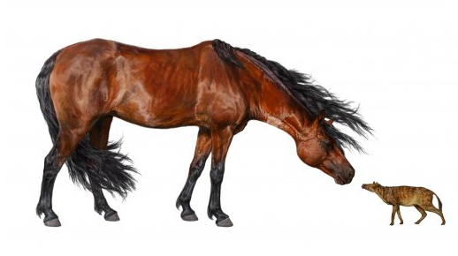
Eohippus:
45,000,000
years ago
Equus: Today!

Slide 23
What is content?

Slide 24
Images
Metadata
Videos
Headers
Articles
Print
Page titles
Words
Conversations
Stories
Stories
EVERYTHING!!!
News & PR
Radio
Tweets
Posts
Chatter

Slide 25

Why should I care?
Creating, offering, serving, and supporting interesting, actionable, sharable content
is vital.
Content is out there. It happens.
We need to control it. And manage it.
Not MORE.
More MEANING.

Slide 26
What makes content valuable?

Slide 27


0 views

Slide 28
The Valuable Content Checklist™
Findable
Readable
Understandable
Actionable
Shareable

Slide 29
The Valuable Content Checklist™
Findable: Can the user find the content?
Readable
Understandable
Actionable
Shareable

Slide 30
The Valuable Content Checklist™
Findable
Readable: Can the user read the content?
Understandable
Actionable
Shareable

Slide 31
The Valuable Content Checklist™
Findable
Readable
Understandable: Can the user understand the content?
Actionable
Shareable

Slide 32
The Valuable Content Checklist™
Findable
Readable
Understandable
Actionable: Will the user want to take action?
Shareable

Slide 33
The Valuable Content Checklist™
Findable
Readable
Understandable
Actionable
Shareable: Will the user share the content?

Slide 34

Use the checklist, but make it matter.
Remember to start with the BIG QUESTIONS:
“What’s the point?” & “Does my user care?”
To get to content that matters, we need to roll
up our sleeves and dig deep into the content
development process.
This is where content strategy comes in!

Slide 35
What is content strategy?

Slide 36
If the goal of content is to provide meaningful, interactive experiences,
then content strategy is to copywriting as information architecture is to design.

Slide 37
How do you ‘strategize’ content?

Slide 38
Content Strategists as Curators

Slide 39

Content Curation
A content strategist as curator
carefully considers the selection
and placement of content to elicit
the desired response.
They create a content experience with purpose, that supports the brand, and establishes a relationship with the audience.

Slide 40
Creating a content gallery

Slide 41
Exhibit a collection’s greatest assets
Recognize that content strategy is a long-term commitment
Assess, analyze, and recommend high-level steps to create more cohesive content
Define big picture objectives and how they affect arrangement of content on the site
Create an overarching strategy that defines how content be should be organized, positioned, and made relevant
Analyzes what is available and desired for publication
Identifies premium content to focus on across the site

Slide 42
Manage the exhibit
• Set a plan for managing web content
• Work at page-level to maintain the integrity of the collection on a day-to-day basis
Critically examine how to strengthen primary content
Position primary content with related content that supports the overall theme
Balance timely and timeless content to create context so that the site continues to feel alive, relevant, and worth returning to

Slide 43
Update the permanent collection
Weaves new relevance into existing site content
Create content packages/groupings that bring archived content back into the moment
Increase the breadth of content you provide
Remembers MORE ≠ MORE MEANINGFUL
Frame strongest assets and communicate in a manner that resonates with audience
Focus on high-traffic-content areas that your client can own to create more authoritative content that will result in higher traffic

Slide 44
Maintain a collection responsibly
Create structure so that content can be dynamically served within the site
Set up long-term management strategy
Create an effective metadata structure to make mapping and moving assets cleaner and more efficient
Use accurate, standardized descriptions for content so the collection is easier for users to find

Slide 45
Use analytics to drive content production
Analytics can:
Demonstrate user flow and identify areas of interest or relevance
Help determine what should be created, what should remain on display, and what should rotate into storage or retirement
Shed light on user trends—where they come from, share practices, bounce rates, time-spent/topic, keyword searches—helping shape the next generation of topics
Track trends and establish patterns, so content updates can be forecasted, ensuring that new content is timely and desirable

Slide 46
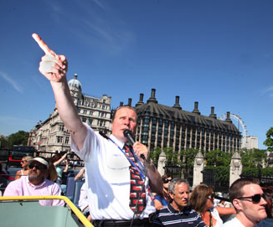
Establish a relationship with your audience
The content curator:
Acts as a guide or docent
Proposes topics for discussion
Sets expectations and tone
Acts as a subject-matter expert
Oversees the transfer of content onto
social and other platforms

Slide 47

Other aspects of digital curatorship
Brand the community’s membership—create a vibe
Position users as publishers
BUT
Establish standards around user-generated
material

Slide 48
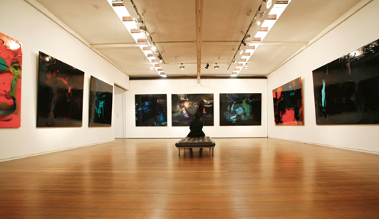
Content waits for no one.
MAKE IT
MATTER

Slide 49
Questions?

Slide 50
Thank you!

